Slide 1

ROLE OF SMART FARMING IN AGRICULTRE MANAGEMENT
Prepare For:
Mis. Sabeen Amjad

Slide 2
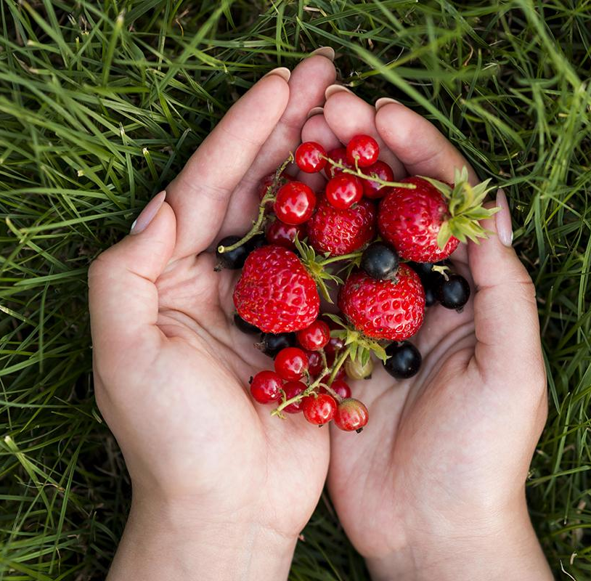
GROUP MEMBERS
Kawaja Abdullah
Basil Ali Khan
Muhammad Shahzaib
20K-0385
20K-0477
20K-1067
Sohaib Ashraf
20K-0488
Ahad Shaikh
20K-0319
Ali Jodat
20K-0155

Slide 3
CONTENT

Slide 4
TABLE OF CONTENTS
01
PROBLEM VS. SOLUTION
02
ALL ABOUT THE PRODUCT
03
MARKET & COMPETITION
04
BUSINESS MODEL PRODUCT
01
02
You can describe the topic of the section here
You can describe the topic of the section here
03
04
You can describe the topic of the section here
You can describe the topic of the section here

Slide 5
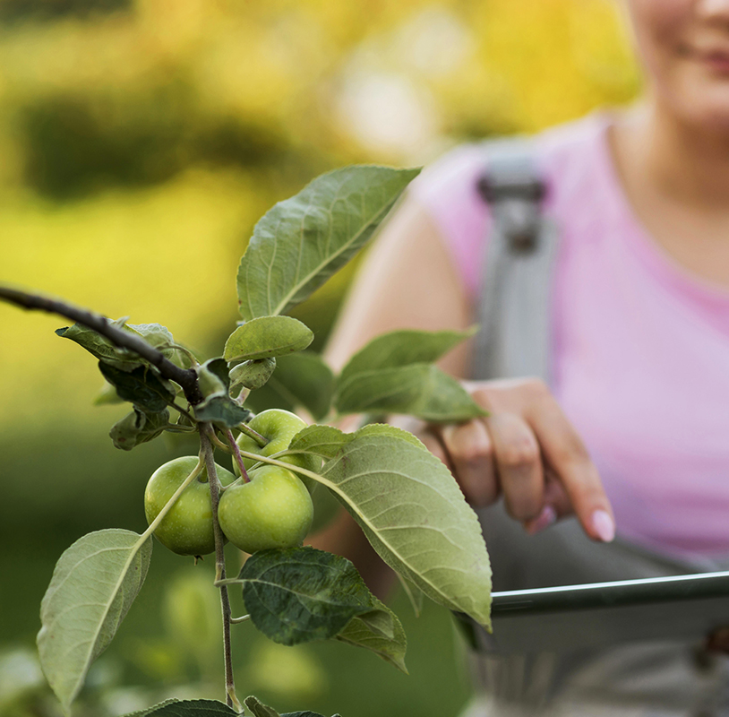
INTRODUCTION
Smart farming, also known as precision agriculture or digital farming, is an innovative approach that integrates advanced technologies and data analytics to optimize agricultural practices. In Pakistan, where agriculture plays a vital role in the economy, smart farming has the potential to revolutionize traditional farming methods and address the challenges faced by farmers. By leveraging cutting-edge technologies such as the Internet of Things (IoT), artificial intelligence (AI), drones, and data analytics, smart farming can significantly improve productivity, reduce resource wastage, and mitigate the effects of climate change.

Slide 6
RESEARCH QUESTIONS
What are the key challenges faced by the agricultural industry in Pakistan in the context of changing monsoon patterns and rising temperatures?
How can smart farming and IoT-based agriculture management contribute to increasing the quantity and quality of agricultural products in Pakistan while reducing labor requirements?
What is the importance of high-speed connectivity, specifically 5G technology, in supporting the implementation of IoT-based applications in smart farming?
What is the current state of 5G technology adoption in Pakistan, and what are the main barriers or challenges in its implementation in the agriculture sector?
What are the potential benefits and impacts of introducing technology and automation in the agriculture sector of Pakistan, and how can it contribute to ensuring a stable food supply?

Slide 7
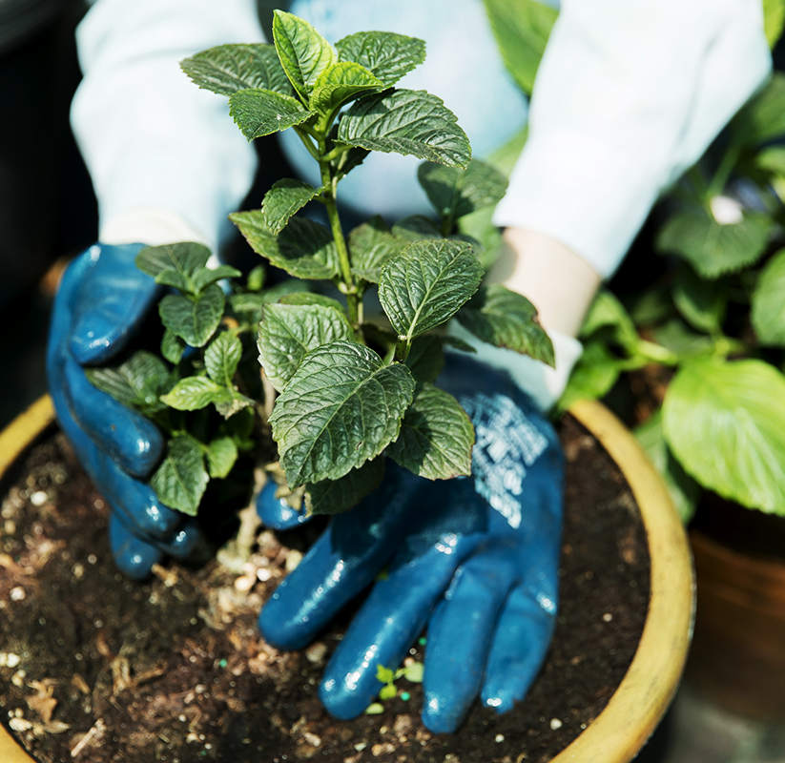
OUR COMPANY
Venus has a beautiful name and is the second planet from the Sun. It’s terribly hot—even hotter than Mercury—and its atmosphere is extremely poisonous

Slide 8
AWESOME
WORDS

Slide 9
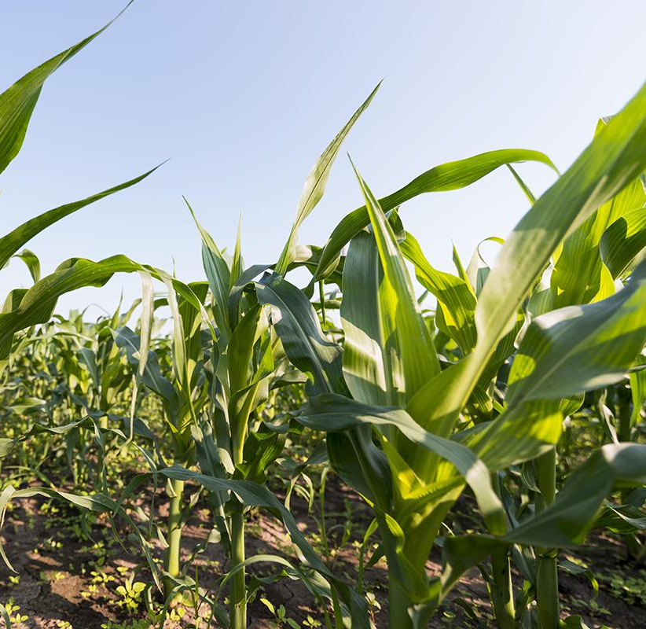
PROBLEM VS. SOLUTION
01
You can enter a subtitle here in case you need it

Slide 10
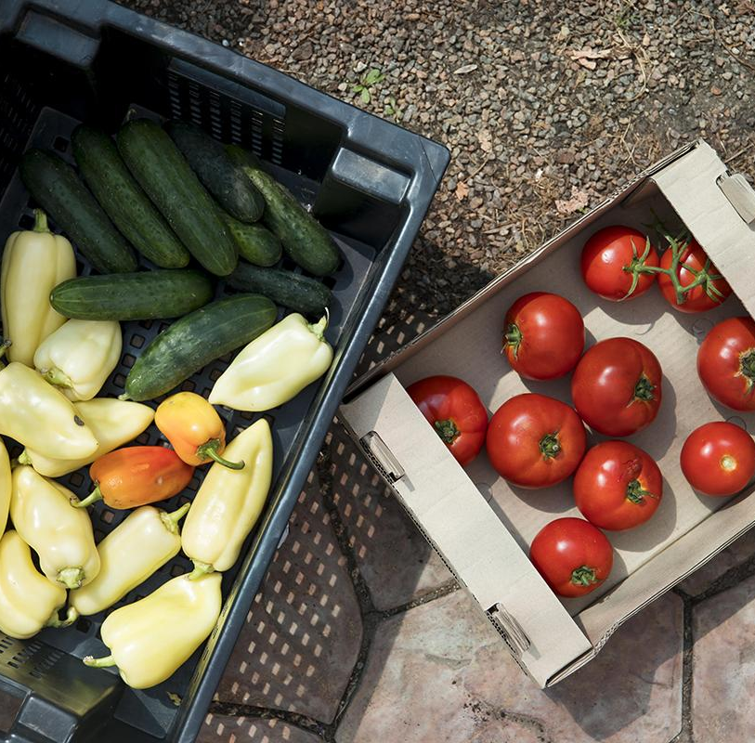
THE PROBLEM
The world population will increase by 2030, which will mean more than 1.2 people to be fed

Slide 11
THEM VS. US
THEM
US
AGRICULTURE
Neptune is the fourth-largest planet in the Solar System
Venus has a beautiful name, but also a poisonous atmosphere

Slide 12
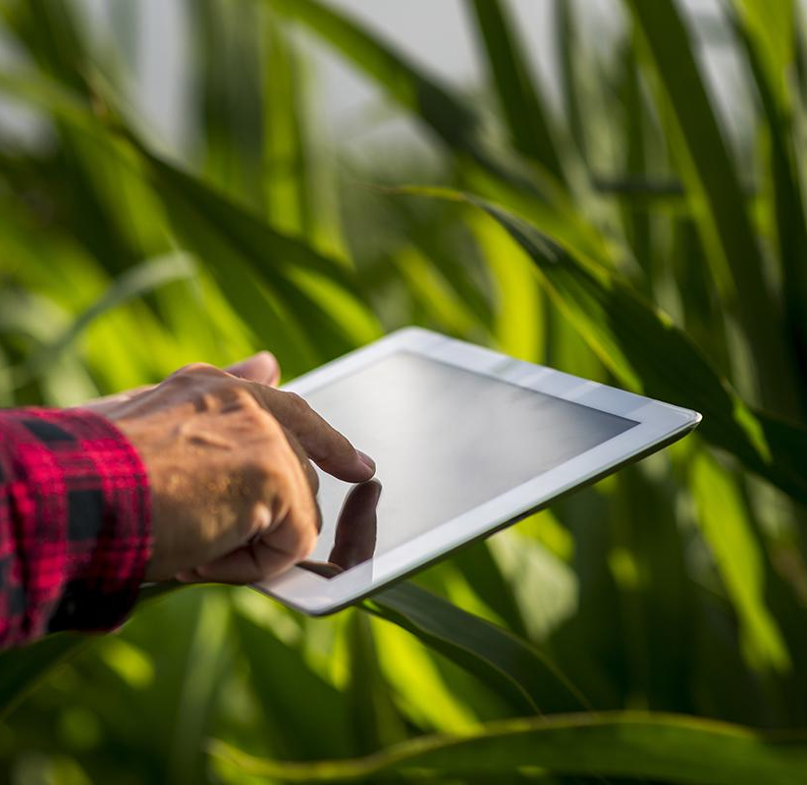
THE SOLUTION
Management with the union of farmers, agricultural crop scientists and technology professionals

Slide 13
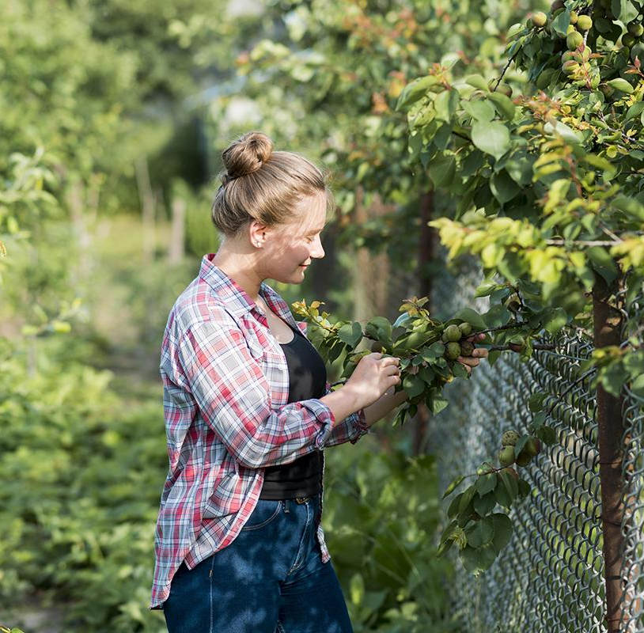
—SOMEONE FAMOUS
“This is a quote, words full of wisdom that someone important said and can make the reader get inspired”

Slide 14
SWOT ANALYSIS
STRENGTHS
WEAKNESSES
OPPORTUNITY
THREATS
Venus is the second planet from the Sun
S
W
Despite being red, Mars is a cold place
Saturn is a gas giant and has several rings
O
T
Neptune is the farthest planet from the Sun

Slide 15
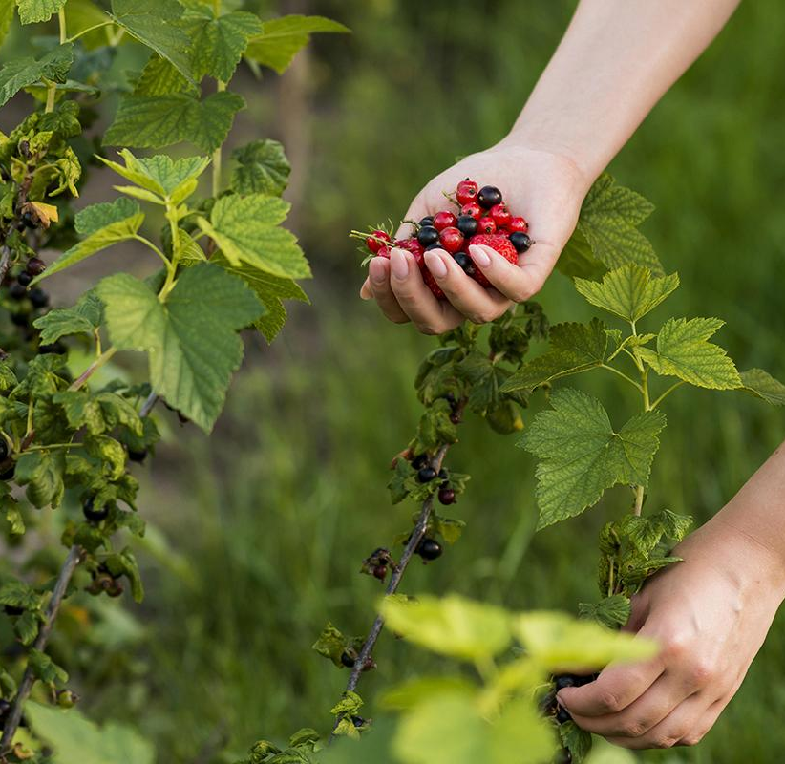
PRODUCT OVERVIEW
VENUS
SATURN
Venus is the second planet from the Sun
Saturn is a gas giant and has several rings

Slide 16
OUR PLANS
$20
$40
$60
Mercury is the closest planet to the Sun. It is for sure, a really hot place
Despite being red, Mars is actually a cold place. It’s full of iron oxide dust
Venus has a beautiful name and is the second planet from the Sun.
It’s terribly hot
BASIC
PRO
PREMIUM

Slide 17
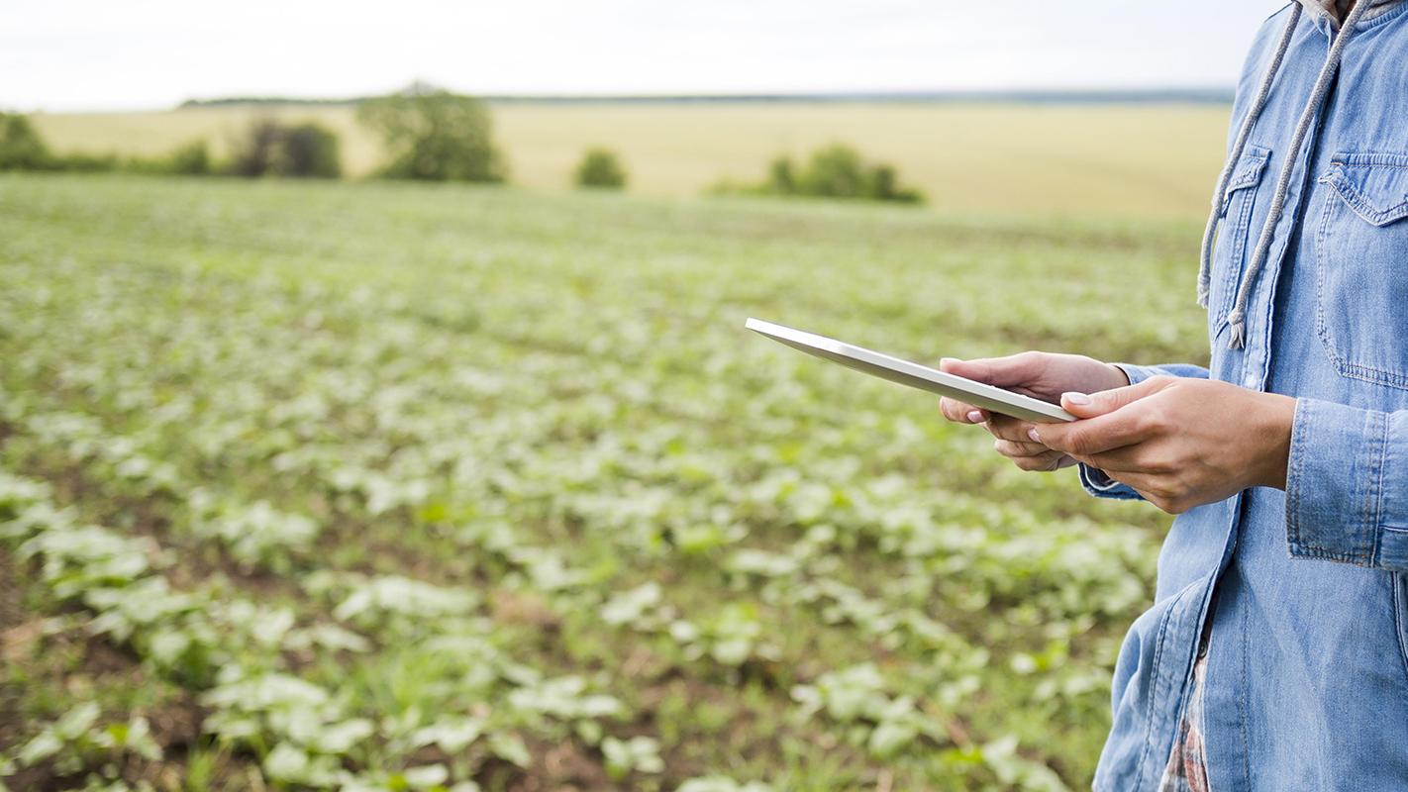
A PICTURE IS WORTH A THOUSAND WORDS
TECH

Slide 18
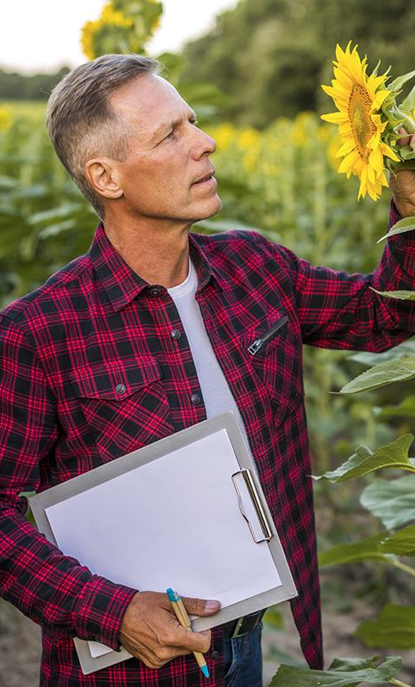
PRODUCT DEMO
You can replace the image the screen with your own work, or add a video or multimedia content here

Slide 19
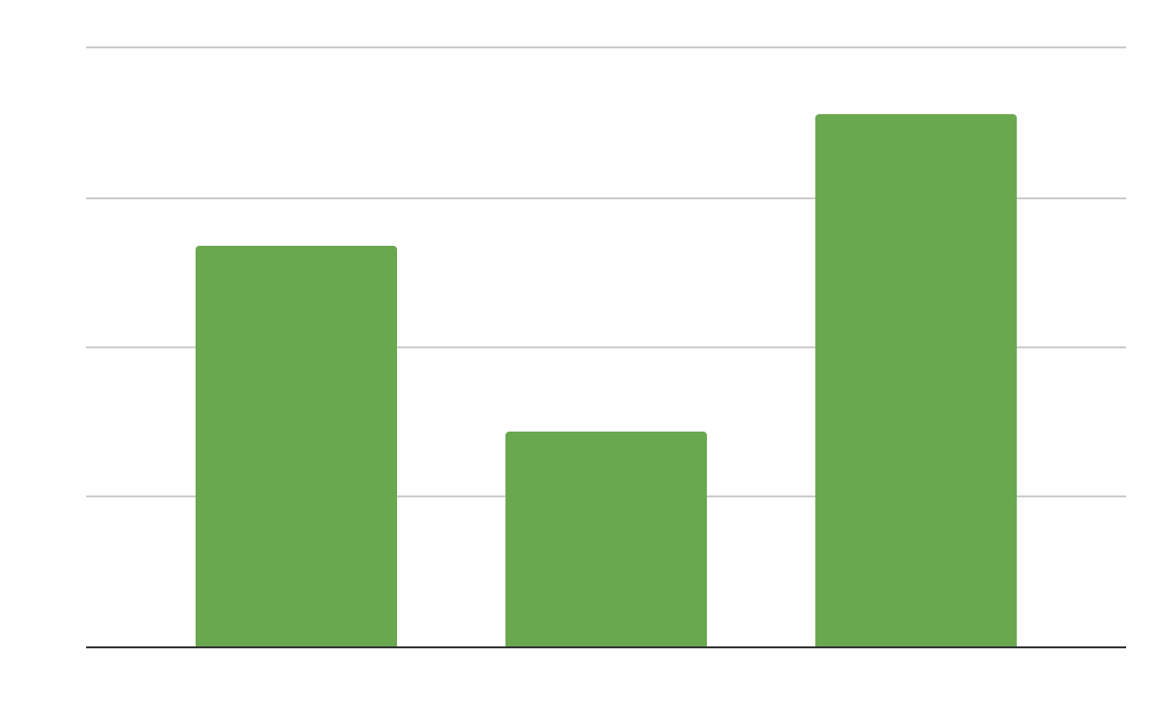
TRACTION
200,000
Registered business
400,000
Average user savings per deal
$600,000
Gross revenues in 2020
Follow the link in the graph to modify its data and then paste the new one here. For more info, click here

Slide 20
CASE STUDY
 | CHALLENGE | RESULTS | SOLUTION
PROJECT 1 | Mercury | Venus | Saturn
PROJECT 2 | Neptune | Mars | Jupiter
PROJECT 3 | Moon | Uranus | Earth

Slide 21
REVIEWS
“Mercury is the closest planet to the Sun. It is for sure, a really hot place”
“Despite being red, Mars is actually a cold place. It is right after the Earth”
—HELENA DOE
—JOHN JAMES

Slide 22
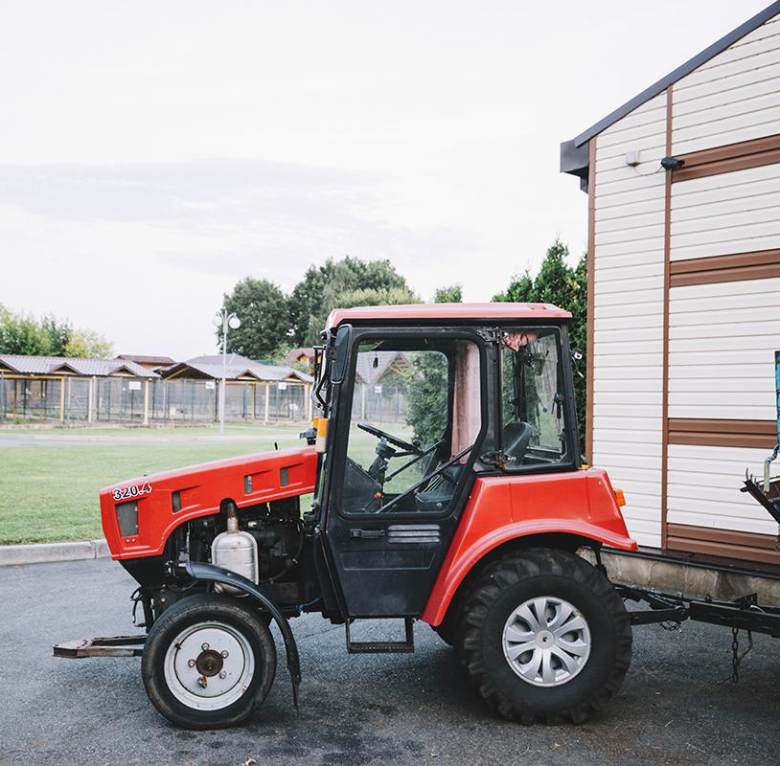
3,405
Big numbers catch your audience’s attention

Slide 23
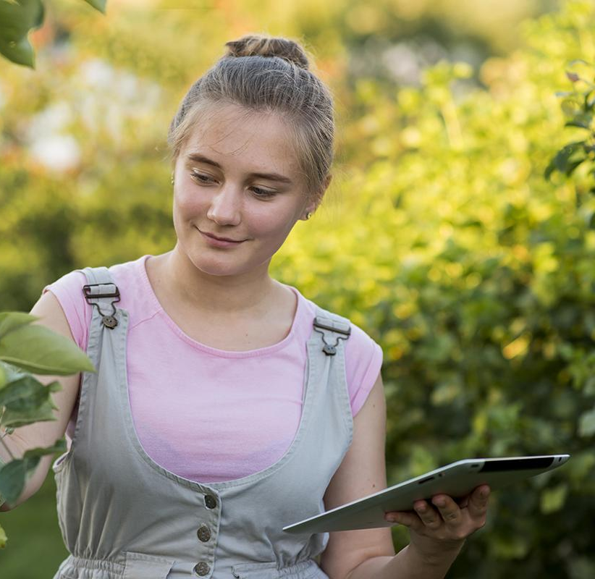
A PICTURE ALWAYS REINFORCES
THE CONCEPT
Images reveal large amounts of data, so remember: use an image instead of long texts

Slide 24
AWARDS
MERCURY
VENUS
MARS
SATURN
NEPTUNE
JUPITER
Mercury is the closest planet to the Sun
Venus is the second planet from the Sun
Despite being red, Mars is a cold place
Saturn is a gas giant and has several rings
Neptune is the farthest planet from the Sun
It’s the biggest planet in the Solar System

Slide 25
MARKET SIZE
70%
MARS
Despite being red, Mars is a cold place
40%
VENUS
Venus is the second planet from the Sun

Slide 26
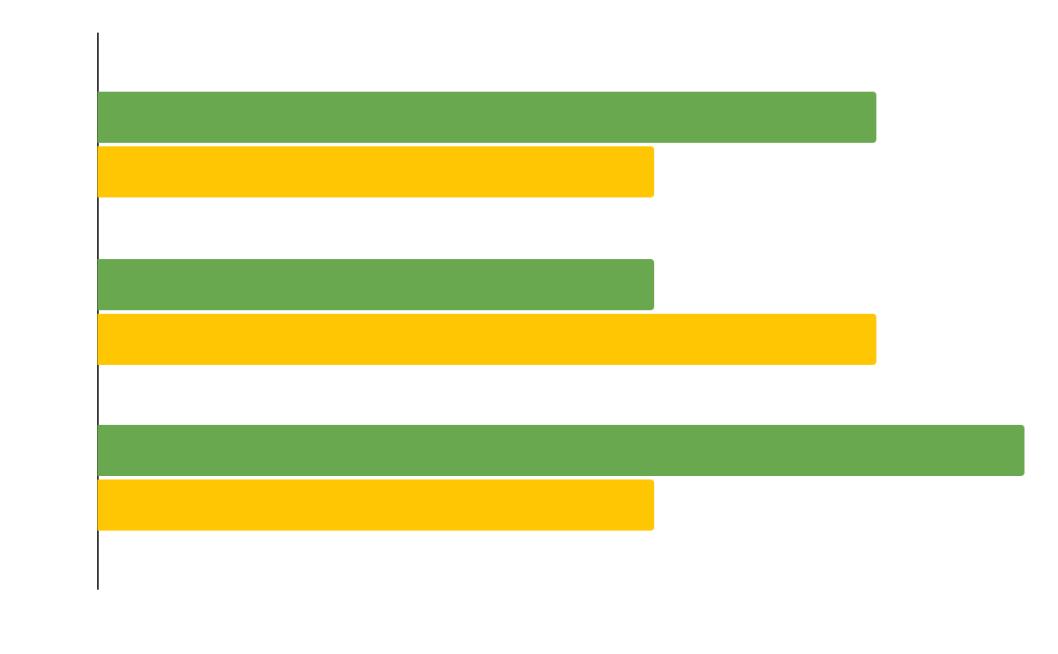
TARGET
AGE
INTERESTS
VENUS
MARS
SATURN
It’s the second planet from the Sun
Despite being red, Mars is a cold place
It’s a gas giant and has several rings
Female
Male
60%
Female
Follow the link in the graph to modify its data and then paste the new one here. For more info, click here
40%
Male

Slide 27
TIMING
DAY 1
DAY 2
DAY 3
DAY 4
DAY 5
MARS
VENUS
MERCURY
SATURN
JUPITER
Despite being red, Mars is a cold place
It has a nice name, but it’s terribly hot
Mercury is the closest planet to the Sun
Saturn is a gas giant and has several rings
It’s the biggest planet in the Solar System

Slide 28
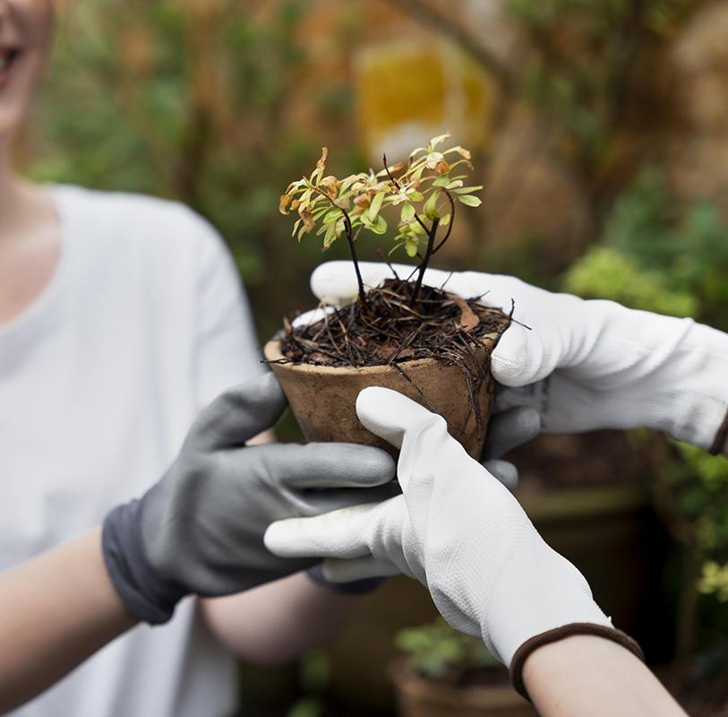
COMPETITORS
MERCURY
VENUS
JUPITER
Mercury is the closest planet to the Sun
Venus is the second planet from the Sun
It’s the biggest planet in the Solar System

Slide 29
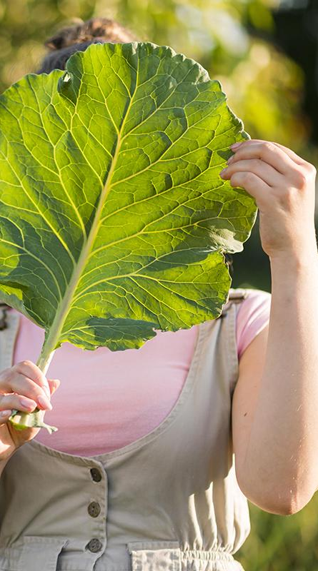
BUSINESS MODEL
MARKETING
TRAINING
Despite being red, Mars is a cold place
Jupiter is the biggest planet of them all
TECHNOLOGY
ASSESSMENT
Venus is the second planet from the Sun
Neptune is far away from Earth

Slide 30
PREDICTED GROWTH
78%
15M
VENUS
40K
It has a nice name, but it’s terribly hot
MERCURY
MARS
Mercury is the closest planet to the Sun
Despite being red, Mars is a cold place

Slide 31
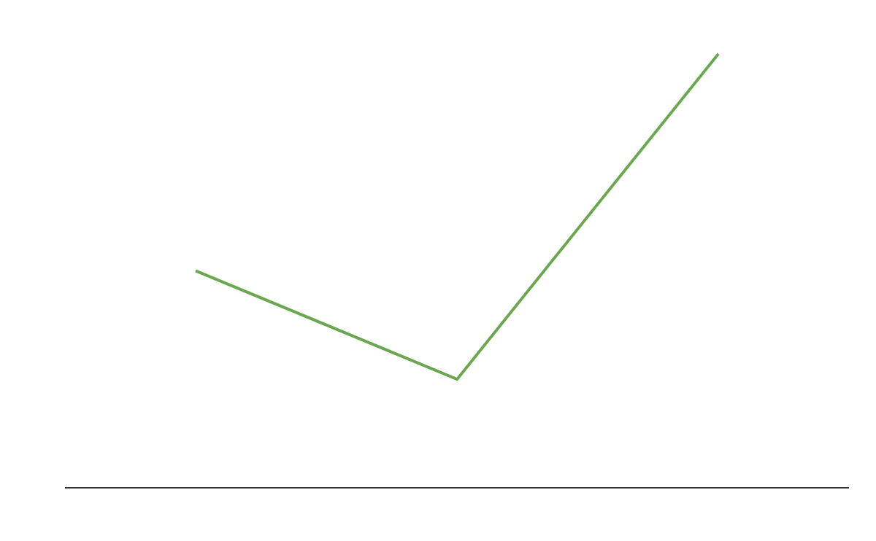
INVESTMENTS
2,400
Jupiter is the biggest planet of them all
1,200
Neptune is the farthest planet from the Sun
4,800
Follow the link in the graph to modify its data and then paste the new one here. For more info, click here
Venus is the second planet from the Sun

Slide 32
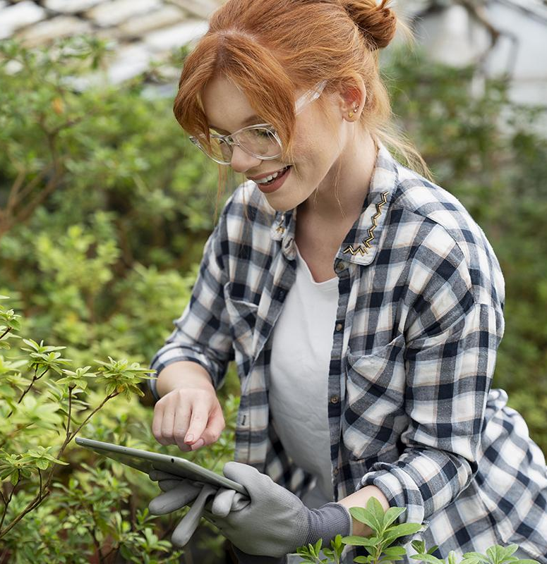
THANKS!
Do you have any questions?
addyouremail@freepik.com
+91 620 421 838 | yourcompany.com
Please, keep this slide for the attribution

Slide 33
ALTERNATIVE RESOURCES
PHOTOS:
Smiley girl picking red berries
Young smiley woman working greenhouse
Woman working her sustainable greenhouse
Medium view agronomist with tablet
Female farmer working greenhouse
Woman taking care their plants greenhouse
Woman taking care their plants
Agronomist looking attentively clipboard

Slide 34
RESOURCES
VECTORS:
Engraving hand drawn fruit collections
Hand drawn vegetables fruits
PHOTOS:
Woman working her sustainable greenhouse
Medium shot girl holding tablet
Female farmer working alone her greenhouse
Top view hands holding fruits
Corn field agriculture concept
Top view fresh vegetables from greenhouse
Close up man using tablet field
Close up hand holding fruits
Woman holding tablet farm field
Agronomist inspecting sunflower
Close up tractor field
Front view girl holding tablet
Women taking care their plants
Woman working hard greenhouse

